Slide 1
Structural Dynamics and Functional Role of Domains in RNA-Binding Proteins: A Focus on Disordered Regions
BACHELOR THESIS PROJECT 1 ABHINAY KUMAR PANDEY 21BT3EP11 under the supervision of PROF. RANJIT PRASAD BAHADUR

Slide 2
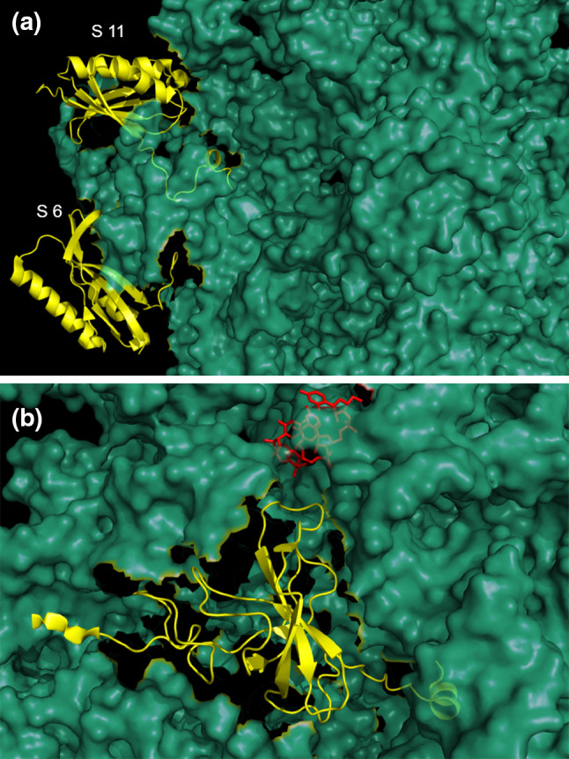
INTRODUCTION
RNA Binding Proteins:RNA-binding proteins (RBPs) are a diverse class of proteins that interact with RNA molecules to regulate various RNA processes.
Functions:
Play critical roles in RNA splicing, transport, translation, and stability.
Influence post-transcriptional gene regulation by binding to different RNA types, including messenger RNA (mRNA), non-coding RNA, and ribosomal RN
Structural Features:
Contain RNA-binding domains (RBDs), such as RNA Recognition Motifs (RRMs) and K Homology (KH) domains, which enable specific interactions with RNA.
Also include intrinsically disordered regions (IDRs), which lack a fixed 3D structure and provide flexibility for dynamic interactions.

Slide 3
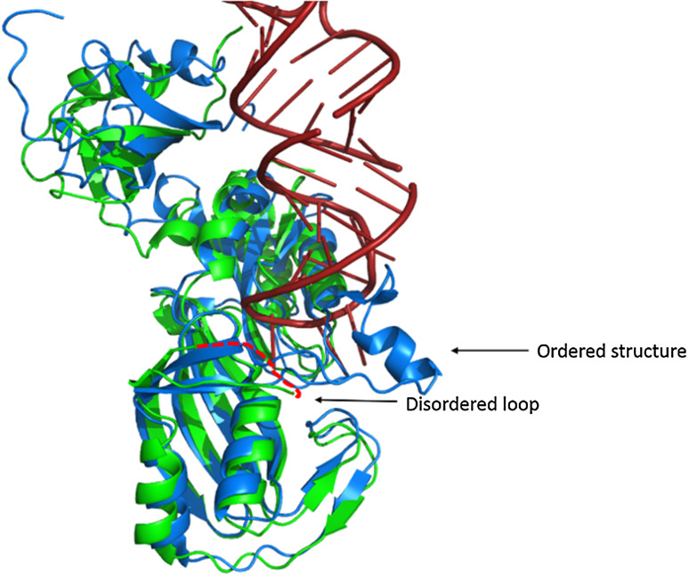
Impact of IDR Disruptions on RNA Interactions and Diseases
How IDR Disruptions Affect RNA Interactions
Impairs adaptability for binding RNA targets.
Causes misfolding and sequestration of RBPs, disrupting RNA functions.
Mislocalizes RBPs, preventing access to correct RNA targets.
Implications in Diseases
Neurodegenerative Disorders:
ALS: Aggregated RBPs (e.g., TDP-43, FUS) disrupt RNA stability and splicing.
SMA: IDR mutations in SMN proteins impair splicing, leading to motor neuron degeneration.
Cancers:
Aberrant RNA Processing: IDR disruptions in RBPs (e.g., hnRNPA1, HuR) lead to faulty splicing and RNA regulation.
Tumor Progression: Misregulated RBPs enhance cell survival and metastasis.

Slide 4
OBJECTIVES
Identify and analyze domain-disordered sequences within RNA-binding proteins (RBPs).
Explore the contribution of intrinsically disordered regions (IDRs) to RNA-protein interactions.
Investigate the role of IDRs in RNA regulation and processing, including splicing, transport, and translation.
Examine how disruptions in IDRs affect RNA interactions, leading to diseases such as neurodegenerative disorders and cancers.
Lay the groundwork for understanding how mutations or misfolding in IDRs contribute to disease mechanisms.
Provide insights for developing targeted therapeutic strategies to restore proper RNA-protein interactions.

Slide 5
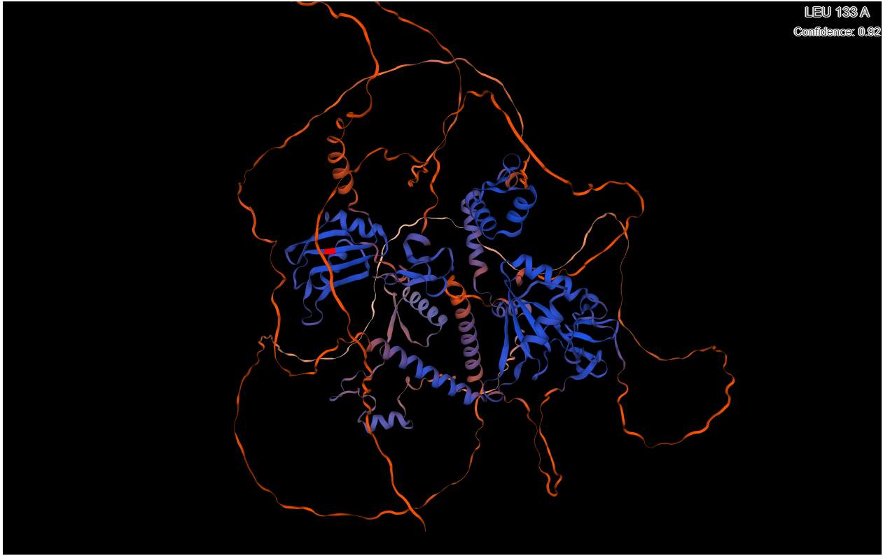
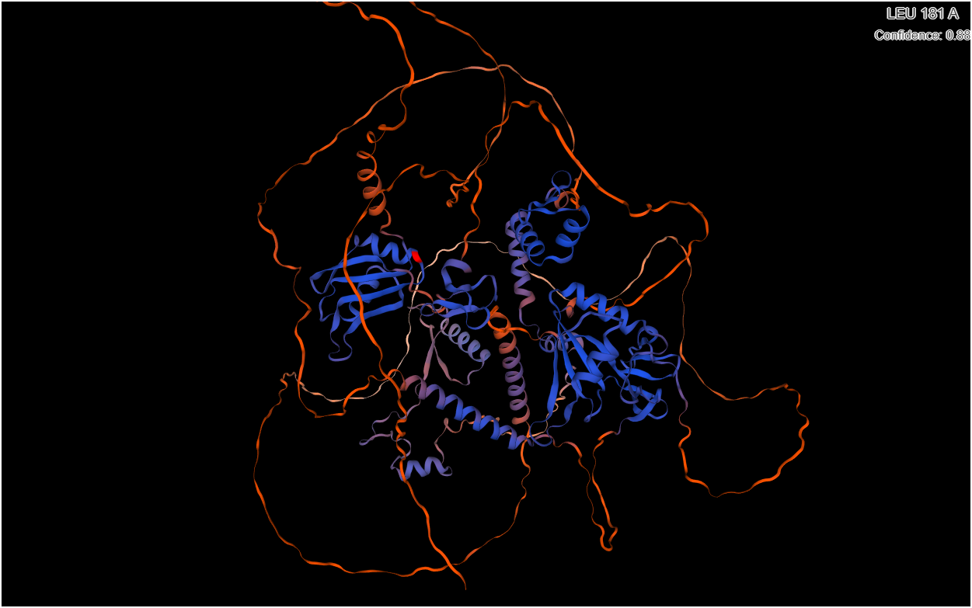
TOOLS AND METHODOLOGY
Python: For automating data processing, filtering UniProt IDs, downloading sequences, and domain annotation.
Libraries:
pandas: Data manipulation and filtering.
openpyxl: Reading and writing Excel files.
wget: Automated downloads of FASTA and XML files.
os: Managing folder structures and file paths.
IUPred3: Prediction of intrinsically disordered regions (IDRs) in proteins
Long Run: Predicts larger, broader disordered regions.
Short Run: Detects localized disordered regions
UniProt: A comprehensive protein sequence and functional annotation database used to filter proteins with solved structures and extract domain information.
PDB: A global repository of 3D protein structures, essential for studying protein structures and interactions, including disordered regions and RNA binding.

Slide 6
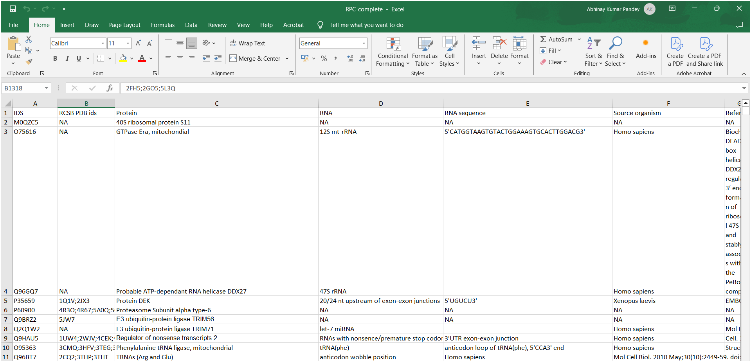
METHODS:
Data Collection and Filtering:
Retrieved 1,433 RNA-binding protein (RBP) as reported by Gerstberger et al Filtered 658 unique UniProt IDs with solved structures (PDB IDs)

Slide 7
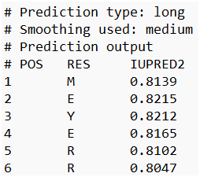
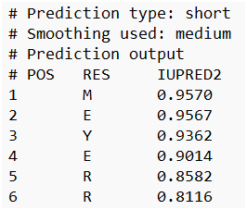
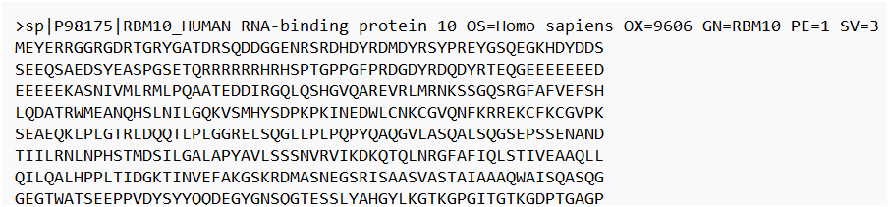
METHODS:
Sequence Retrieval and Disorder Prediction:
Download UniProt sequences:
wget https://rest.uniprot.org/uniprotkb/{uniprot_id}.fasta.
Download PDB sequences:
wget https://www.rcsb.org/fasta/entry/{pdb_id}.
Disorder Prediction:
Using IUPred3 for long and short run disorder prediction:
python3 iupred3.py {fasta_file} long/short.
Scores > 0.5 indicate disordered residues;
Scores < 0.5 indicate ordered residues

Slide 8
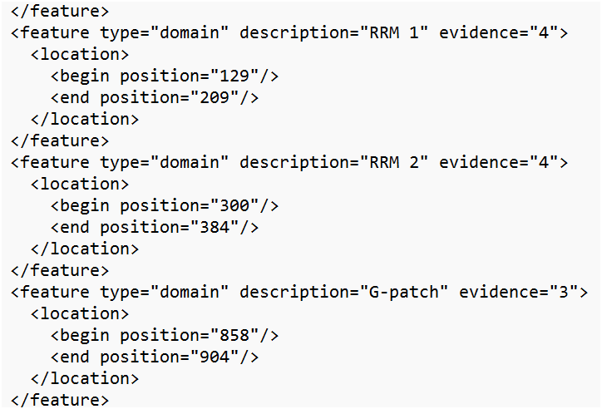
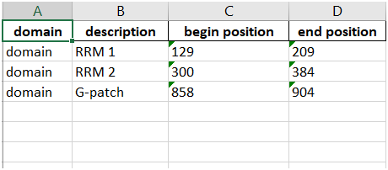
METHODS:
Domain Annotation and Data Integration:
Download UniProt XML files: wget https://rest.uniprot.org/uniprotkb/{uniprot_id}.xml.
Parse domain details (name, start, end positions) using Python scripts.
Data Integration:
Combine IUPred scores with domain information. Create domain-specific Excel sheets summarizing UniProt IDs, domain sequences, and disorder scores

Slide 9
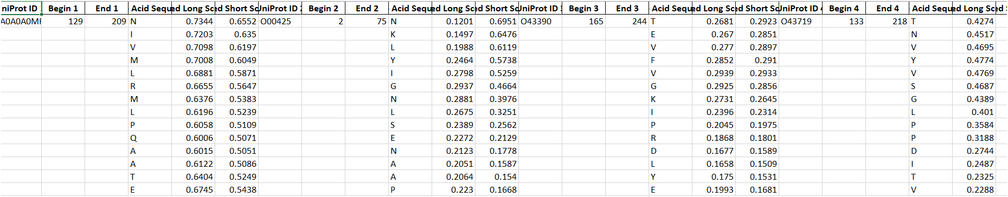
RESULTS & CONCLUSION:
Domain Sequences Identified:
Different domain sequences found across various UniProt RNA-binding proteins (RBPs).
Domains play critical roles in RNA regulation and interactions.
Disorder Profiles Using IUPred:
IUPred scores were used to predict intrinsic disorder in domain sequences.
Disordered regions: IUPred scores > 0.5.
Ordered regions: IUPred scores < 0.5.

Slide 10
FUTURE WORKS DISCUSSION:
Multi-parameter Correlational Analysis:
Conduct a detailed analysis comparing structural and functional characteristics of domain vs. non-domain residues at both the residue and motif levels.
Investigate how these characteristics correlate with intrinsic disorder across different RBPs.
Ranking of Key Parameters:
Rank the parameters identified in the analysis by their significance.
Determine the most influential features for constructing an effective intra-domain protein intrinsic disorder predictor.
Protein Structure and Binding Partner Analysis:
Obtain representative protein structures for each interactive domain.
Analyze their complex formation with frequent binding partners and observe binding dynamics in these complexes.
Influence of Physico-chemical Parameters:
Monitor how significant physico-chemical parameters (domain and non-domain) affect protein-substrate binding interactions.
Analyze how changes in these parameters influence the intrinsic disorder landscape during protein-RNA interactions.
Comparative Study of Inter-domain vs Intra-domain Interactions:
Conduct a comparative study between intra-domain and inter-domain interactions in RBPs.
Focus on how parametric behaviors differ in protein interactions within and between domains.

